Slide 1

INTERCOM PROGRAMMING AND MANUFACTURING COMPANY (IPMC)
SCHOOL OF CYBERSECURITY | EC-COUNCIL
C|CT 2023/2024 ACADEMIC YEAR
CERTIFIED CYBERSECURITY TECHNICIAN (C|CT)
DIPLOMA IN CYBERSECURITY
SARPONG AMOH ALEXANDREG
JAN 16TH, 2025

Slide 2
EXECUTIVE SUMMARY
The project provide,
Detection
Monitoring
Protection of systems
In reference to that,
The network should be well-planned to facilitate the needs of the Nursing Home.
The network should be simple to use, modify and troubleshoot.
The network should be governed by policies.
A recovery plan should be implemented incase of disaster/ hardware failure.

Slide 3

PROJECT SCOPE
OBJECTIVES
Uninterrupted access to high-speed internet.
Organized health records for future reference.
Continuous communication throughout the nursing home's departments that is network capability for end-to-end connectivity.
A network that demonstrates a secure network for protecting medical information and staff research projects.
Providing wireless limited internet access for the staff and visitors of the nursing home.

Slide 4
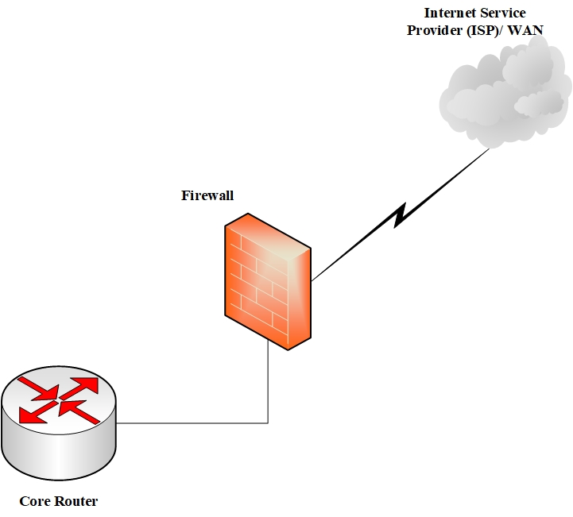
Core Layer

Slide 5
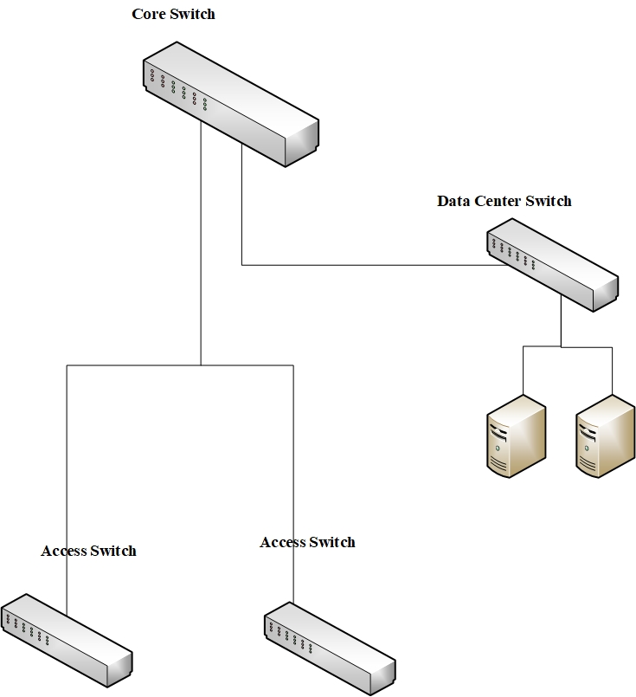
Distribution Layer

Slide 6
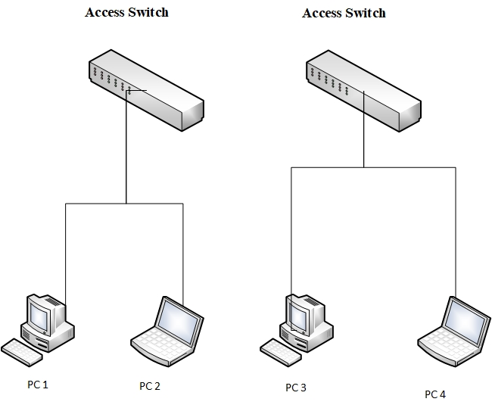
Access Layer

Slide 7
NETWORK REQUIREMENTS
INTERNET SERVICE PROVIDER (ISP)
High-speed internet service provider
The speed should be about 1gb/s
Server - Dell PowerEdge Server Tower Model T560
It handles large amounts of data and complex calculations in conditions of limited rack space.
Its efficiency infrastructure, quick task completion.
Router - Cisco 8818 Route Processor
Inbuilt firewall feature
Encryption Feature
Intrusion Detection Service (IDS)
Accommodate an upgraded bandwidth of 518 Tbps

Slide 8
Hardware Firewall - Netgate 1541 1U Base pfSense Security Gateway
High performance and reliability
It manageable and ease to use that is user friendly interface
Its security features that is AES-NI encryption acceleration, Intrusion Detection and Prevention (IDP), VPN support (OpenVPN, IPsec, PPTP).
Core Switch - Cisco Catalyst 9600 Series Switch
It has very less rate of failure.
It has very high scalability.
It is ungradable.
Access Switches - Cisco Catalyst 4503 E-Series Switch
Number of ports (Maximum of 48 ports)
High performance
Great efficiency

Slide 9
Wireless Access Point (WAP) - Cisco Catalyst Wireless 9163E
It provides the flexibility to expand your 6-GHz wireless coverage
It caters for a wide range and more spectrum of use
It helps ensure uninterrupted wireless access
Cables - CAT 6 graded Shielded Twisted Pair (STP)
Its maximum transmission speed of 1000mbps/100 meters
Workstations - HP Envy x360
Its Intel vPro technology for remote management
Manageability integration kit for easy deployment
Sure start for secure boot protection
BIOSphere for firmware protection

Slide 10
Workstation - Samsung Galaxy Tab S10 Ultra
Its timely security patches and feature enhancements.
Global service centers and online resources ensure prompt support.
Disaster Recovery Devices - CyberPower Cp600LCD 340W Backup Utilities
Its long battery life
Disaster Recovery Devices - Elite 100 kW Generator by Guardian
Reliability
Quick
Efficient
Supported electrical product

Slide 11
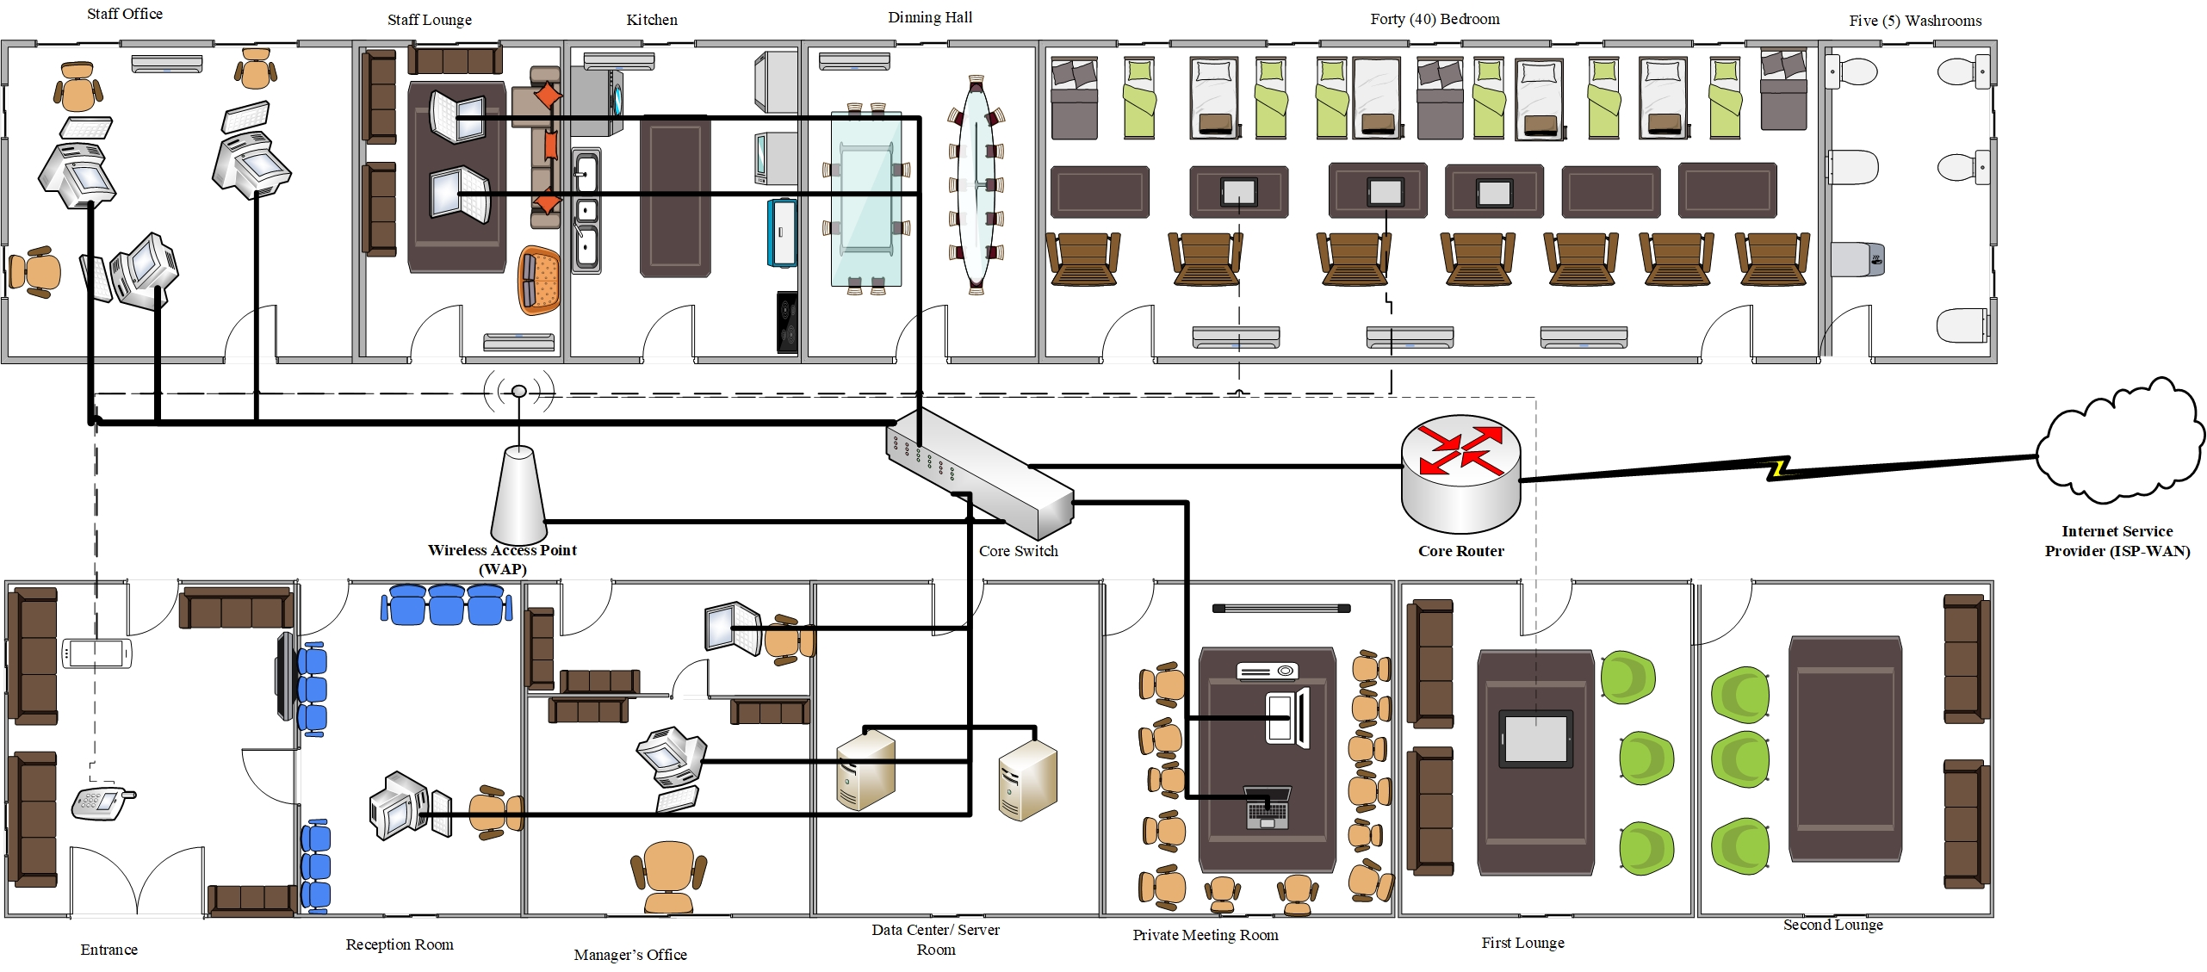
PROPOSED NETWORK TOPOLOGY DIAGRAM

Slide 12
SECURITY ISSUES IN EXISTING NETWORK INFRASTRUCTURE
Absence of a firewall
No Information Technology (IT) Department
Lack of Segmentation and VLAN Technology
No Managed Access Switches
Insufficient Servers
Data Security (Insufficient Encryption)
Poor Physical Security
Insufficient Wireless Access Point (WAP)

Slide 13
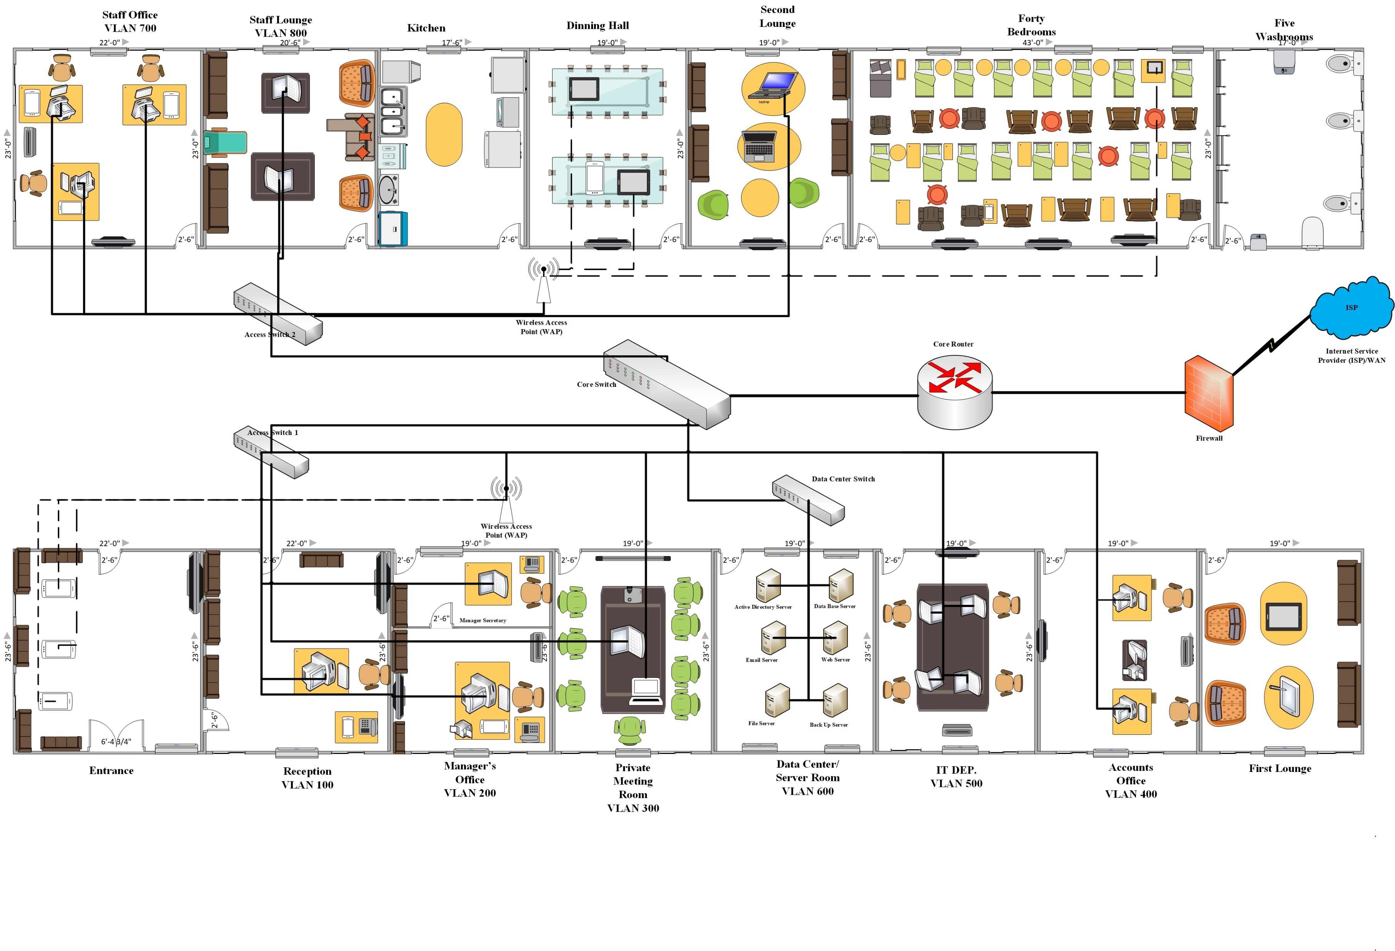
PROPOSED PROTOTYPE NETWORK TOPOLOGY

Slide 14
Authentication Method
Active Directory
It manages the systems and users of the network.
It is developed by Microsoft that provides a centralized repository for storing information about objects on a network, such as users, groups, computers, and printers.
It provides a centralized authentication and authorization to network resources.
Software Firewall – Wazuh Application Firewall
Intrusion detection and prevention systems (IDPS)
Web application firewall (WAF) capabilities
Integration with Security Information and Event Management (SIEM) systems

Slide 15
DATA STORAGE
Network-Attached Storage (NAS) - HPE 3PAR 9450 Device
It support multiple protocols, including Fibre Channel
Support data encryption
It handles over two (2) million Input/output operations per second (IOPS)
Virtual Private Network (VPN) Technology
In order for Government Health Service (GHS) to access the medical records of the old people in the nursing home.
It uses protocols such as,
Internet Protocol Security (IPsec)
Generic Routing Encapsulation (GRE)
Encapsulating Security Payload (ESP) – One of IPsec protocols that uses encryption and encapsulation to protect the confidentiality of data.
Internet Key Exchange (IKE) - Tool used in communicating in different protocols.

Slide 16
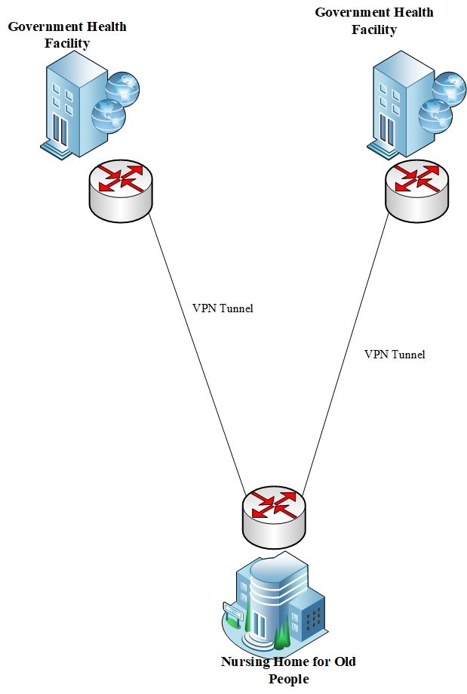
VPN TECHNIQUE

Slide 17
IP Addressing System/Scheme
The project uses IPv4 Class C IP address scheme, 192.168.1.0 (a private IP) due to the fact that a Class C contains enough hosts for all the connected clients in the nursing home.
IP: Class C - 192.168.1.1
Subnet Mask: 255.255.255.0
Total Available Hosts: 254
Network Address/ Base Network: 192.168.1.0
Range: 192.168.1.1 - 192.168.1.254
Broadcast: 192.168.1.255

Slide 18
SECURITY AND NETWORK POLICIES
E-mail Policy
Internet Equipment Policy
Computer Network and Internet Access Policy
Wireless Policy
Wireless Network Security
User Account Access
Hardware Firewall
Reporting of Incidents
Physical Security
Disaster Recovery Policies

Slide 19
SECURITY AND VULNERABILITY ASSESSMENT
Manual scan for the assessment using Network Mapper (NMAP) in order to examine the Common Vulnerability and Exposure (CVE) and Common Vulnerability Scoring System (CVSS) to enable us to gather the risk score.
Information of the systems
Target System: Metasploitable, IP Address 10.10.1.129
Attacker System: KALI (v6.11.2), IP Address 10.10.1.38
The vulnerability report should include information,
Open ports
Service and
Version.
You do the manual scanning using this command;
kali@kali:~$ nmap -sV 10.10.1.129

Slide 20
Results of scanning the targeted system

Slide 21
Find the Common Vulnerability Exploit (CVE) ID of ftp vsftpd 2.3.4 running on port 21 at https://cve.mitre.org/
The CVE ID is CVE-2011-2523 vsftpd 2.3.4 downloaded between 20110630 and 20110703 contains a backdoor which opens a shell on port 6200/tcp.
Findings
Backdoor Command Execution
https://www.cve.org/CVERecord?id=CVE-2011-2523
Description:
The vulnerability vsftpd 2.3.4 downloaded between 2011/06/30 and 2011/07/03 contains a backdoor which opens a shell on port 6200/tcp.
Publish Date: 2019-11-27 Updated: 2021-04-12

Slide 22
Finding the Common Vulnerability Scoring System (CVSS) - Risk Score
The CVSS Scores for CVE-2011-2523 https://www.cvedetails.com/cve/CVE-2011-2523/ is 9.8 and 10 which indicates Critical
Recommendation
The System Administrators are strongly advised to update to the latest version VSFTPD 3.0.5-13 to protect their servers from exploitation.
Conclusion
This research work implemented VPN security
The designed network used IPsec VPN and GRE to meet up the security measures as demanded by the client
combination of IPsec VPN + GRE will offer a better defense to attacks.

Slide 23

THANK YOU…

